Slide 1

StarAngle: User Orientation Sensing with Beacon Phase Measurements of Multiple Starlink Satellites
Raghav Rathi and Zhenghao Zhang
Department of Computer Science
Florida State University
USA

Slide 2
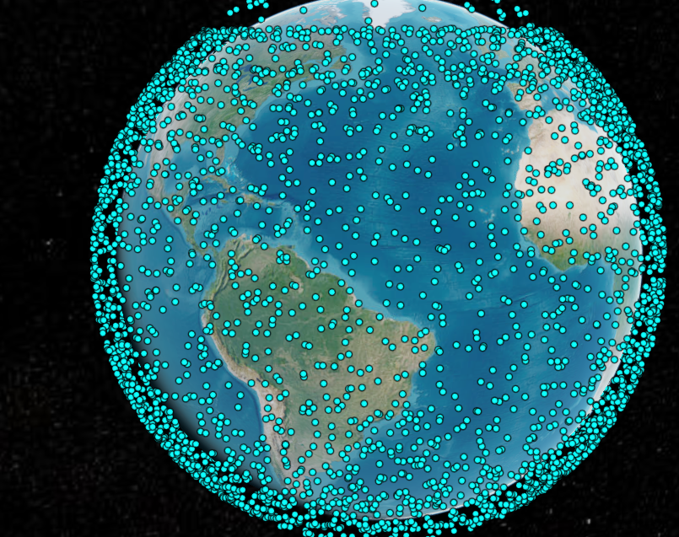
Starlink Satellites
Over 6000 now
Will reach 42000

Slide 3
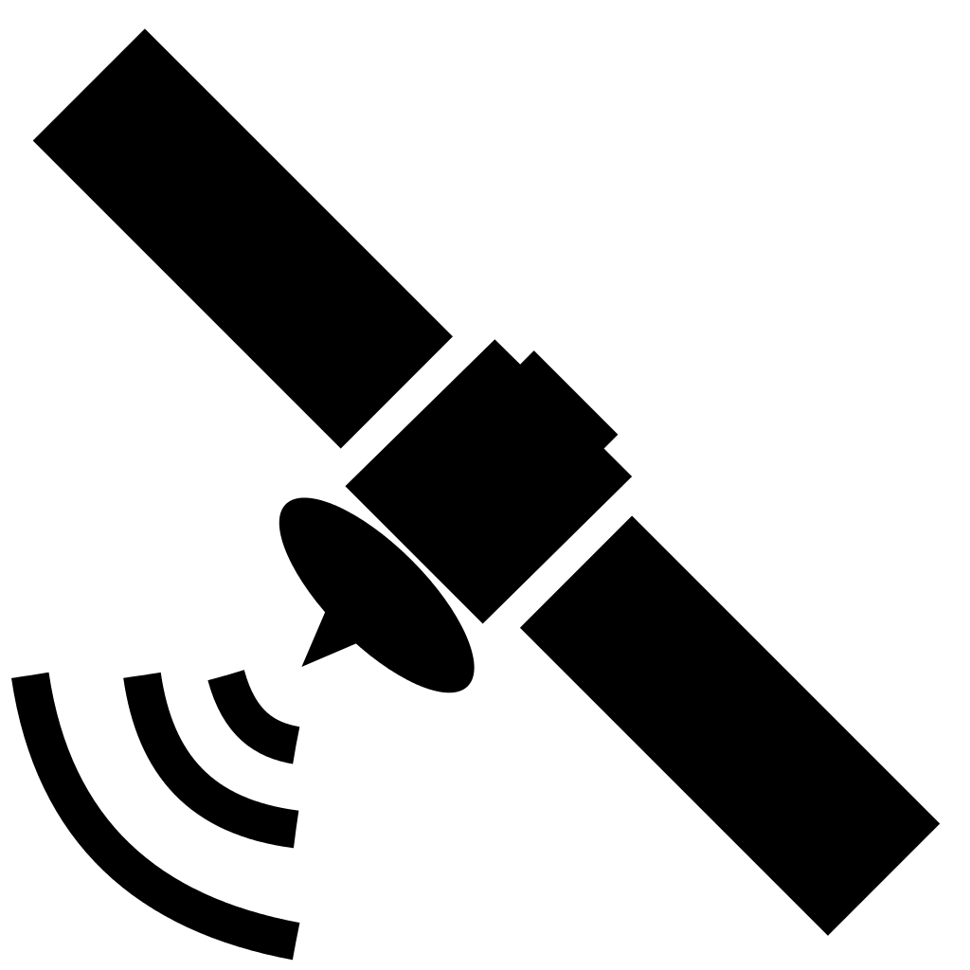
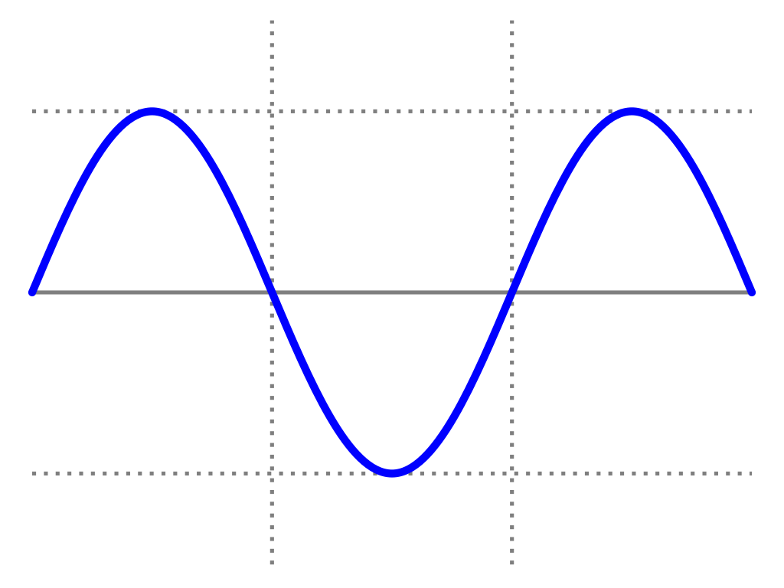
Starlink Satellite Beacons
This Photo by Unknown Author is licensed under CC BY-SA
Beacon is a pure sinewave (some around 11.95 GHz)
Each satellite transmit multiple beacons separated by 43945 Hz
This Photo by Unknown Author is licensed under CC BY-SA

Slide 4

Advantages of Using Starlink Beacons
Global coverage
Free (no need to install base stations)
Line of Sight path from the satellite (no multipath)

Slide 5
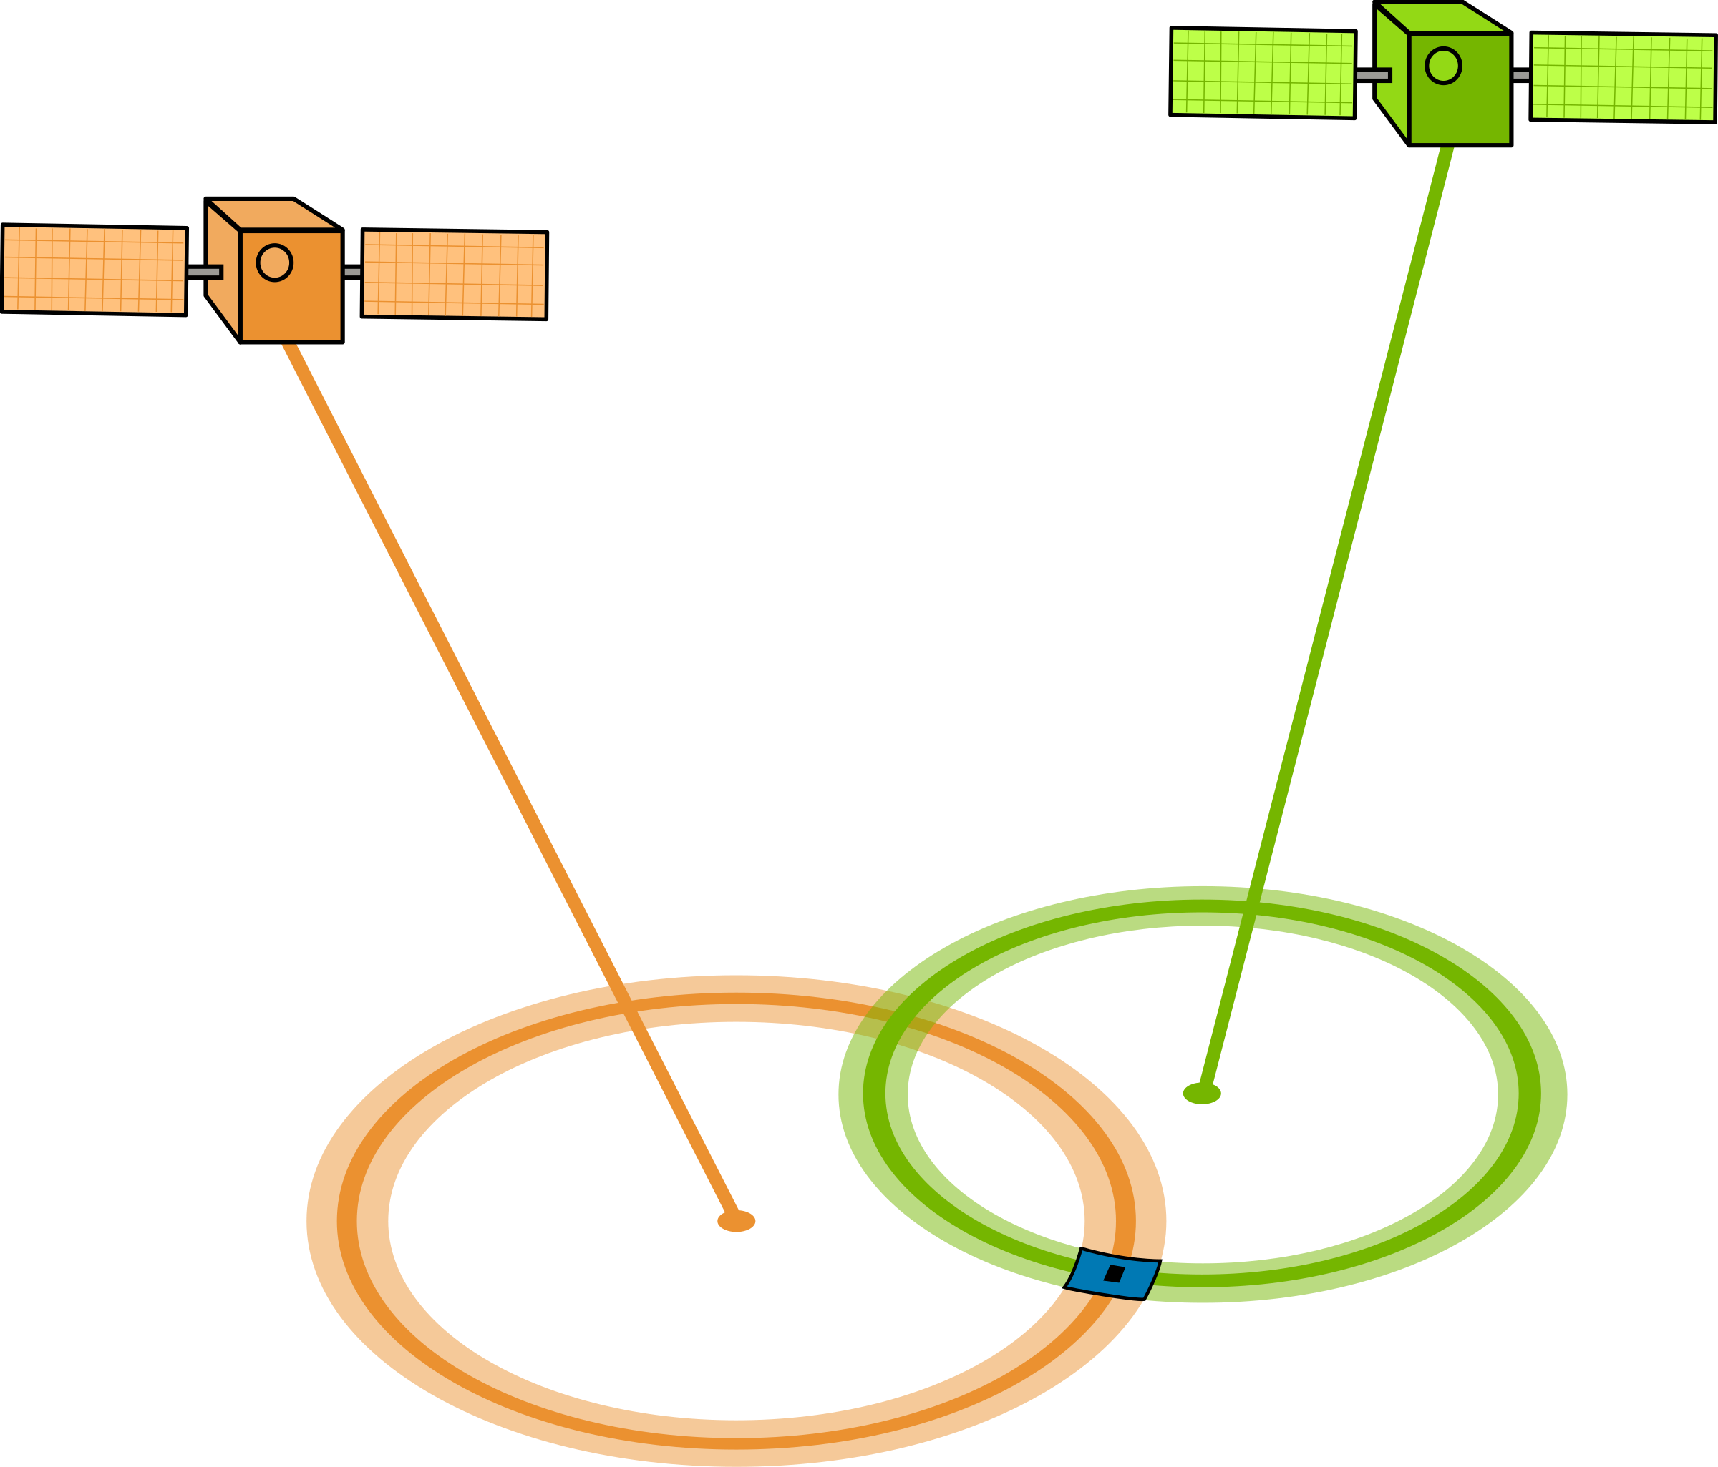
Used in User Localization
Sharbel Kozhaya, Haitham Kanj, and Zaher M. Kassas. 2023. Multi-Constellation Blind Beacon Estimation, Doppler Tracking, and Opportunistic Positioning with OneWeb, Starlink, Iridium NEXT, and Orbcomm LEO Satellites. In 2023 IEEE/ION Position, Location and Navigation Symposium (PLANS). 1184–1195
Sharbel E. Kozhaya and Zaher M. Kassas. 2023. Positioning with Starlink LEO Satellites: A Blind Doppler Spectral Approach. In 2023 IEEE 97th Vehicular Technology Conference (VTC2023-Spring). 1–5.
Chun Yang and Andrey Soloviev. 2023. Starlink Doppler and Doppler Rate Estimation via Coherent Combining of Multiple Tones for Opportunistic Positioning. In 2023 IEEE/ION Position, Location and Navigation Symposium (PLANS). 1143–1153.

Slide 6
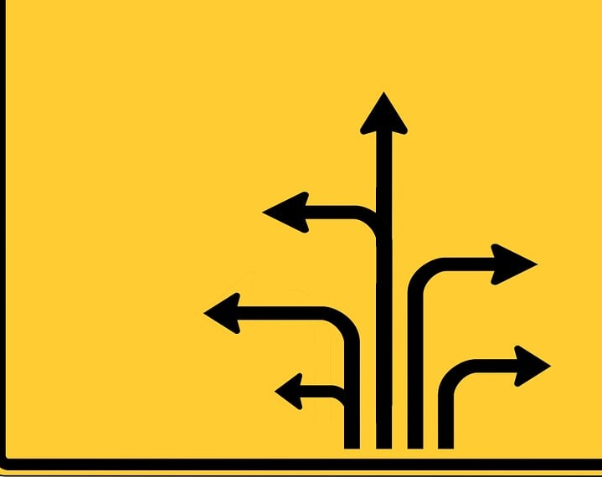
User Orientation
Sometimes the GPS does not know the direction until we start driving

Slide 7
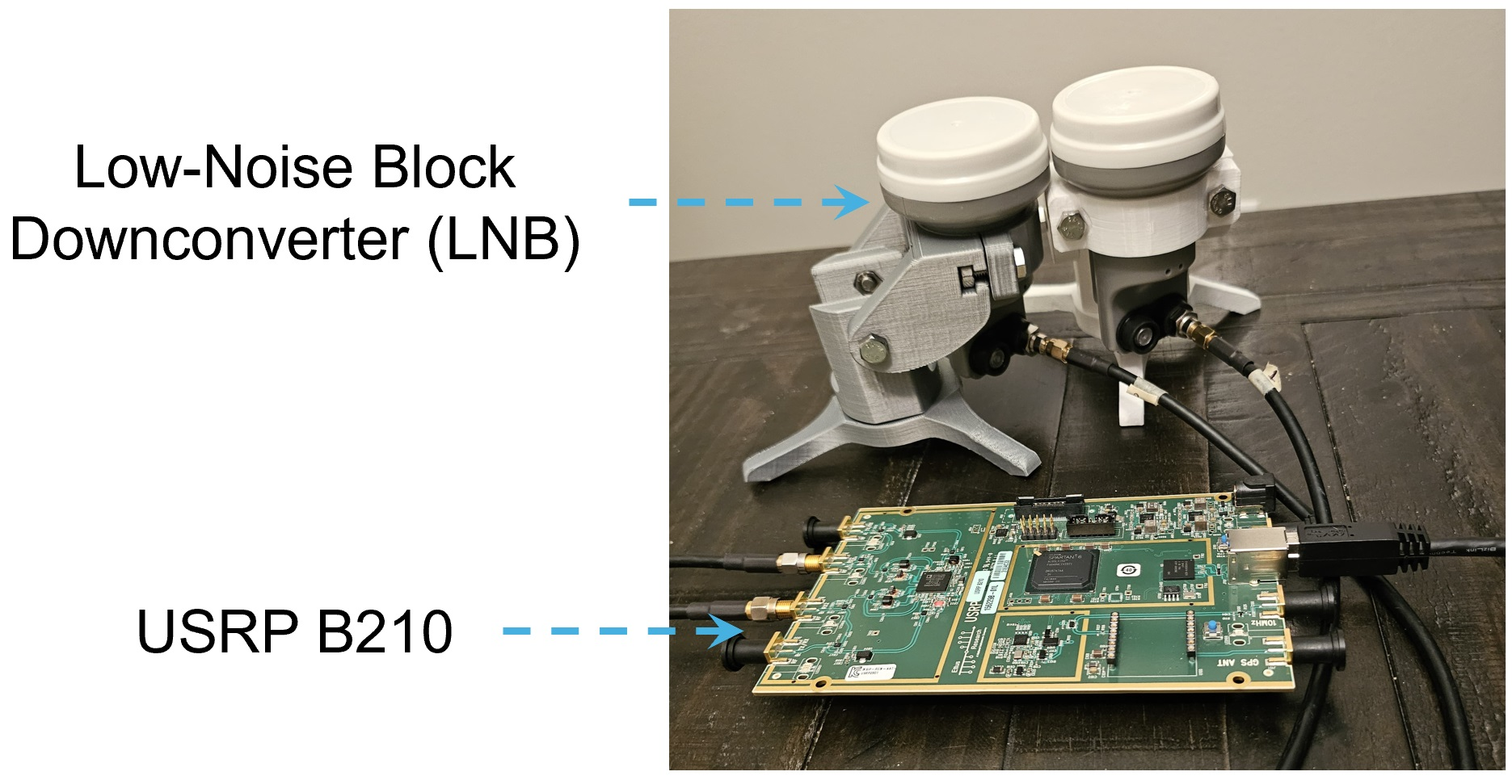
StarAngle

Slide 8
StarAngle
S₁
N
Measure the beacon phase difference
Phase difference is a function of the angle connecting the centers of the LNBs
θ(t)
Commodity LNBs have internal clocks not synchronized with each other

Slide 9
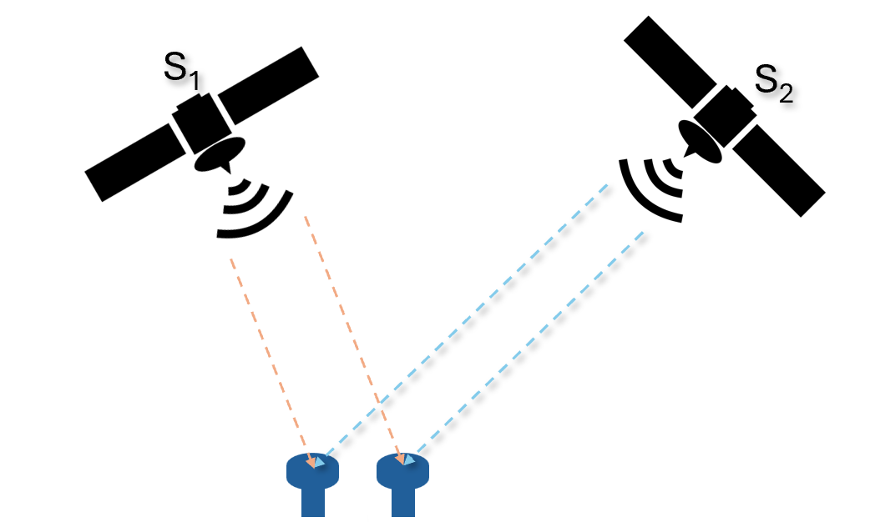
Our solution
Receive from multiple satellites simultensously
The clock difference is cancelled
Θ(t) = θ₁(t) - θ₂(t)

Slide 10
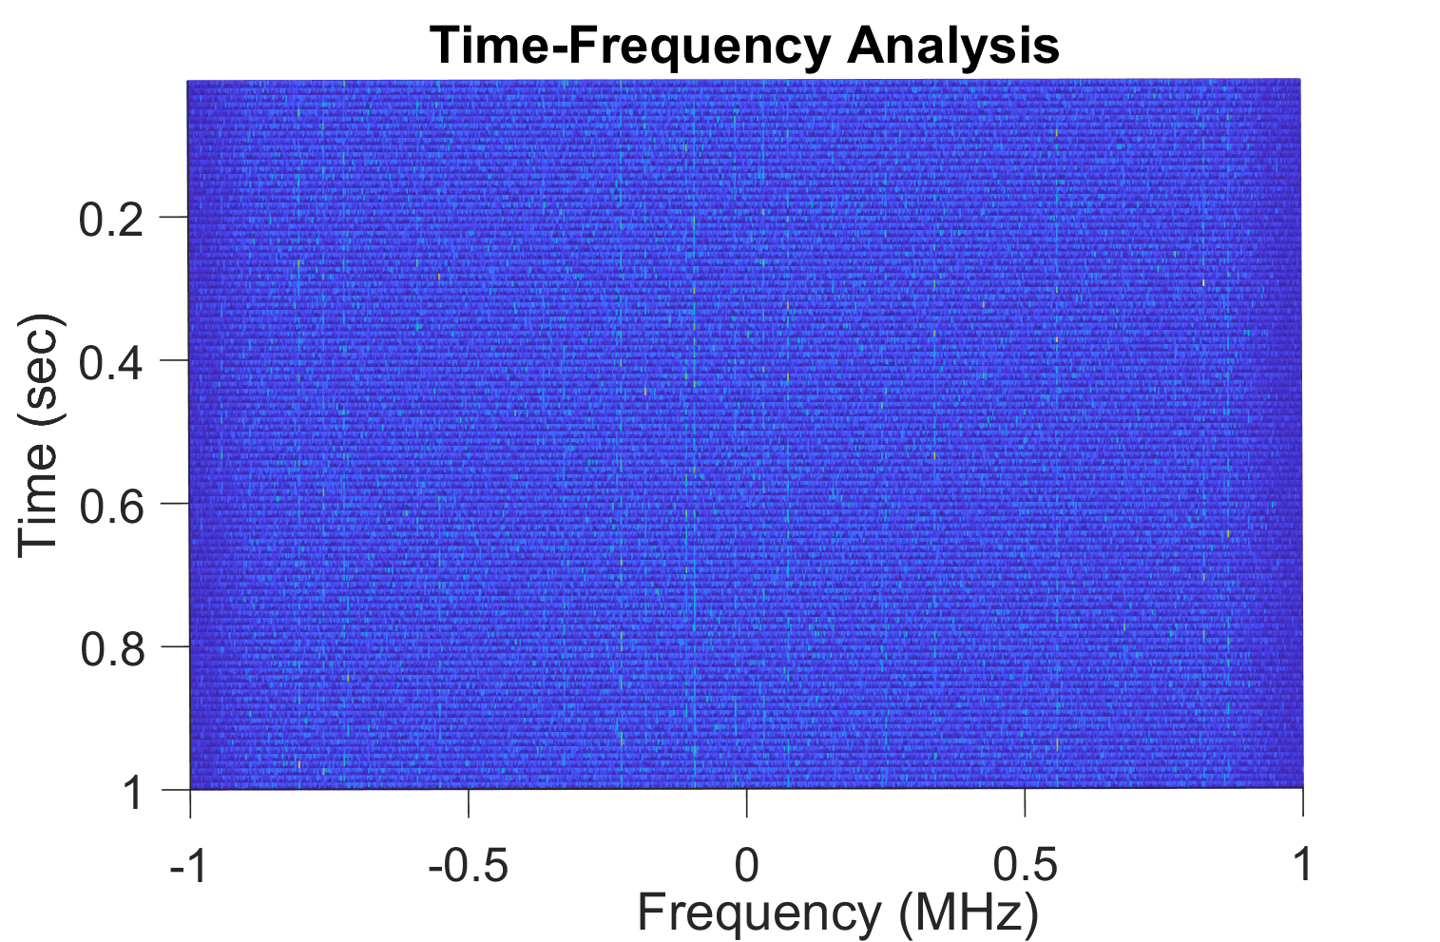
Challenges
Signal can be very weak (-30 dB)
Frequency change due to motion (-4 kHz per second)

Slide 11

StarAngle
Satellite Detection
Phase Measurement
Orientation Estimation
This Photo by Unknown Author is licensed under CC BY-NC

Slide 12
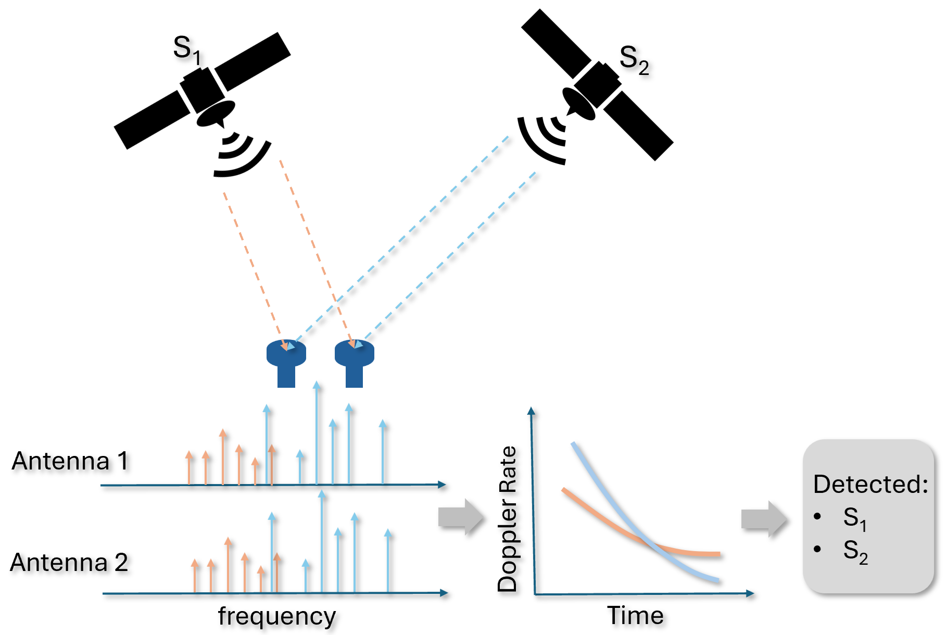
Satellite Detection
Use the Doppler Rate (frequency change rate) to match detected satellites to known satellites

Slide 13
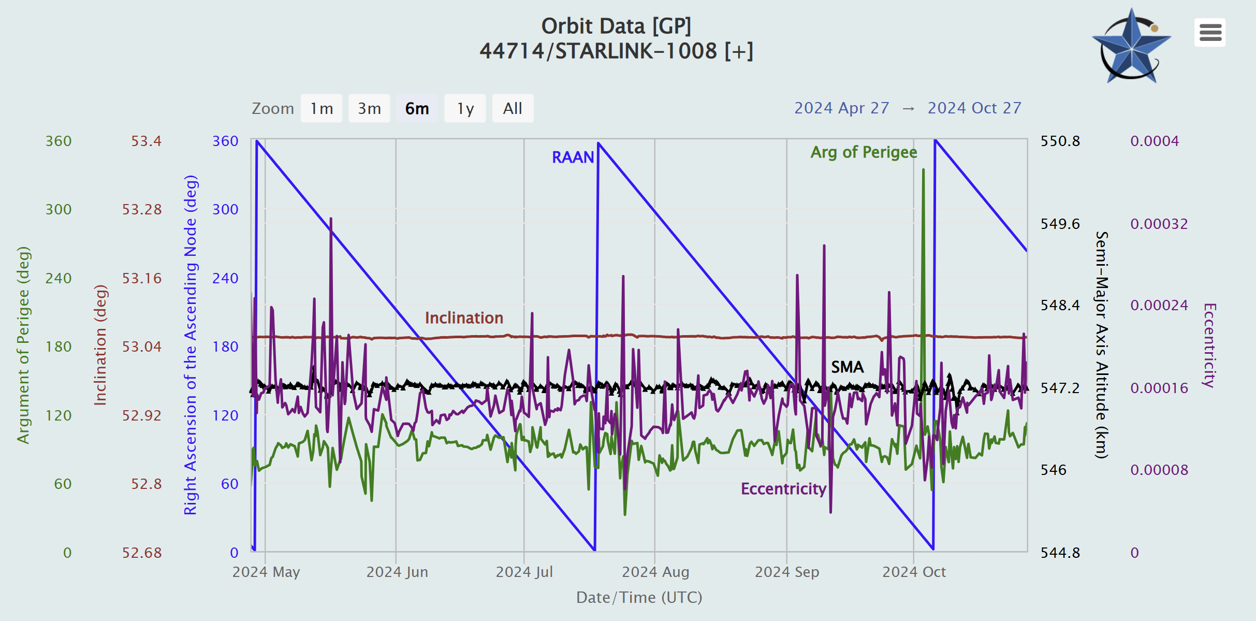
Starlink Satellite Information
Maintained by celestrak
Two Line Elements (TLE)
STARLINK-31569
1 59857C 24097Y 24171.41993056 .00000659 00000+0 15714-4 0 1711
2 59857 42.9992 252.7558 0001247 264.8185 17.8746 15.40707837 19

Slide 14
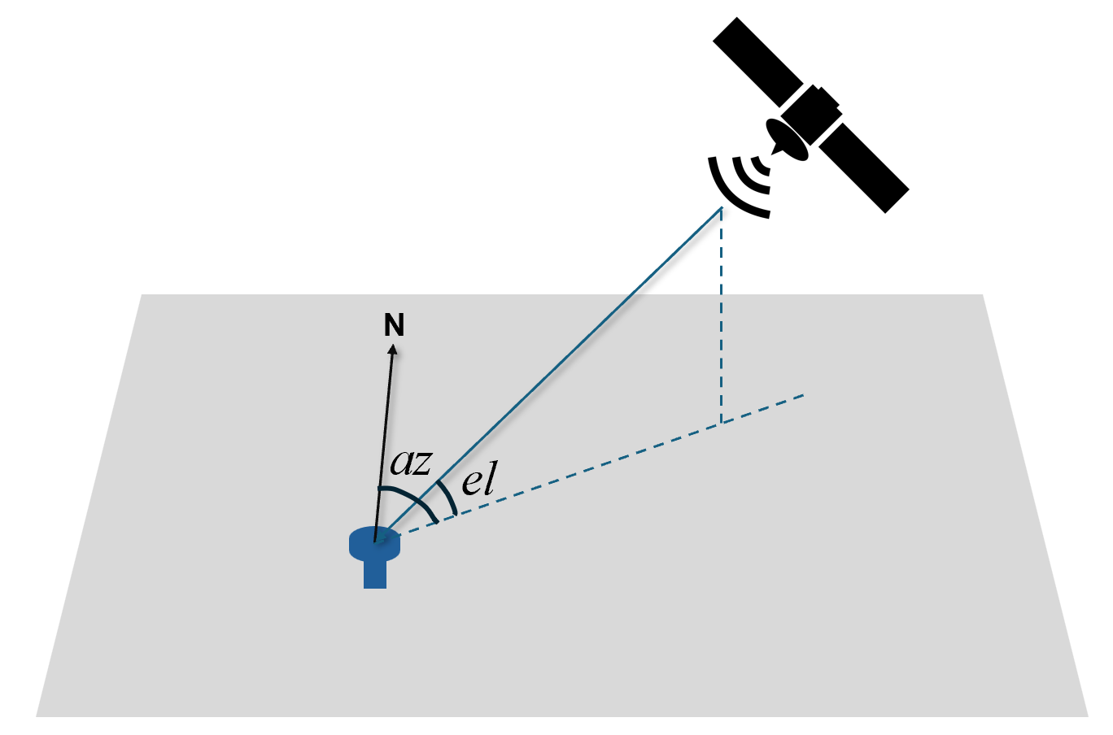
Finding Satellite Motion Parameters
Doppler rate: dopplershift function in Matlab
Azimuth and Elevation angles: the aer function in Matlab

Slide 15
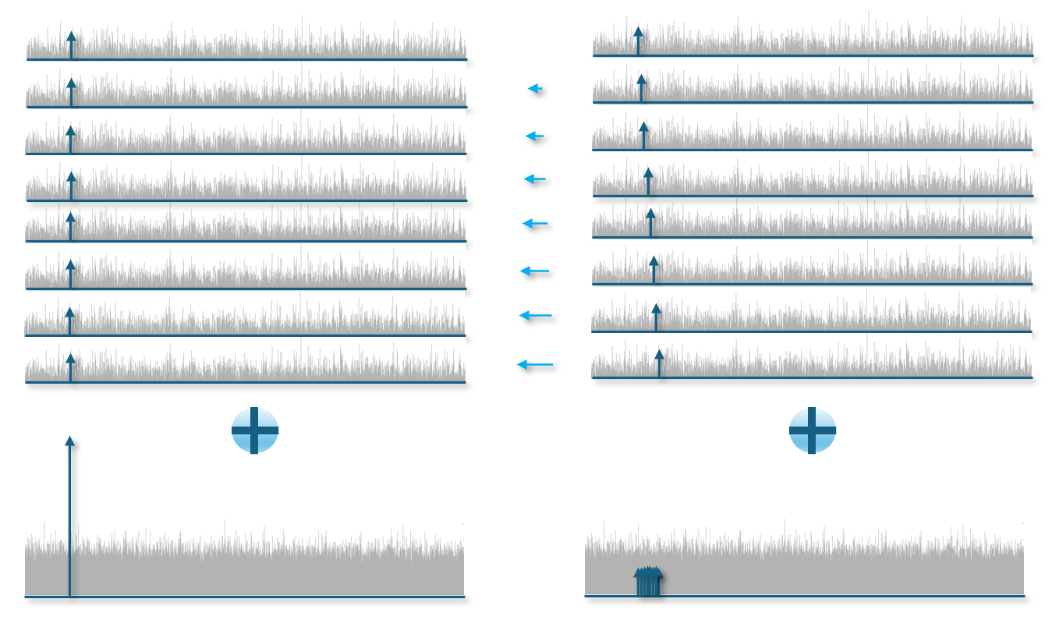
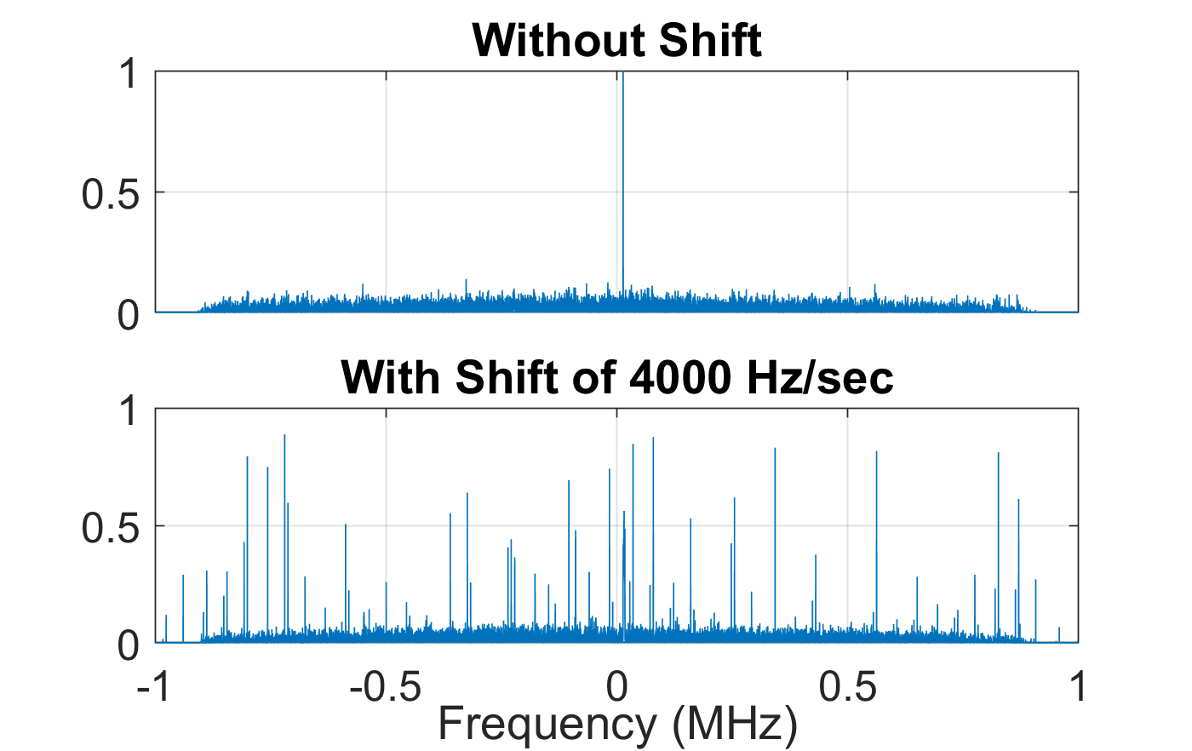
Dealing with Very Weak Signal with Unknown High Doppler Rate
Divide the signal into 10-ms segments
Do a linear scan of Doppler rates from -10, -9, …, 9, 10 kHz
Add the FFT up. When Doppler rate roughly match, will see a peak

Slide 16
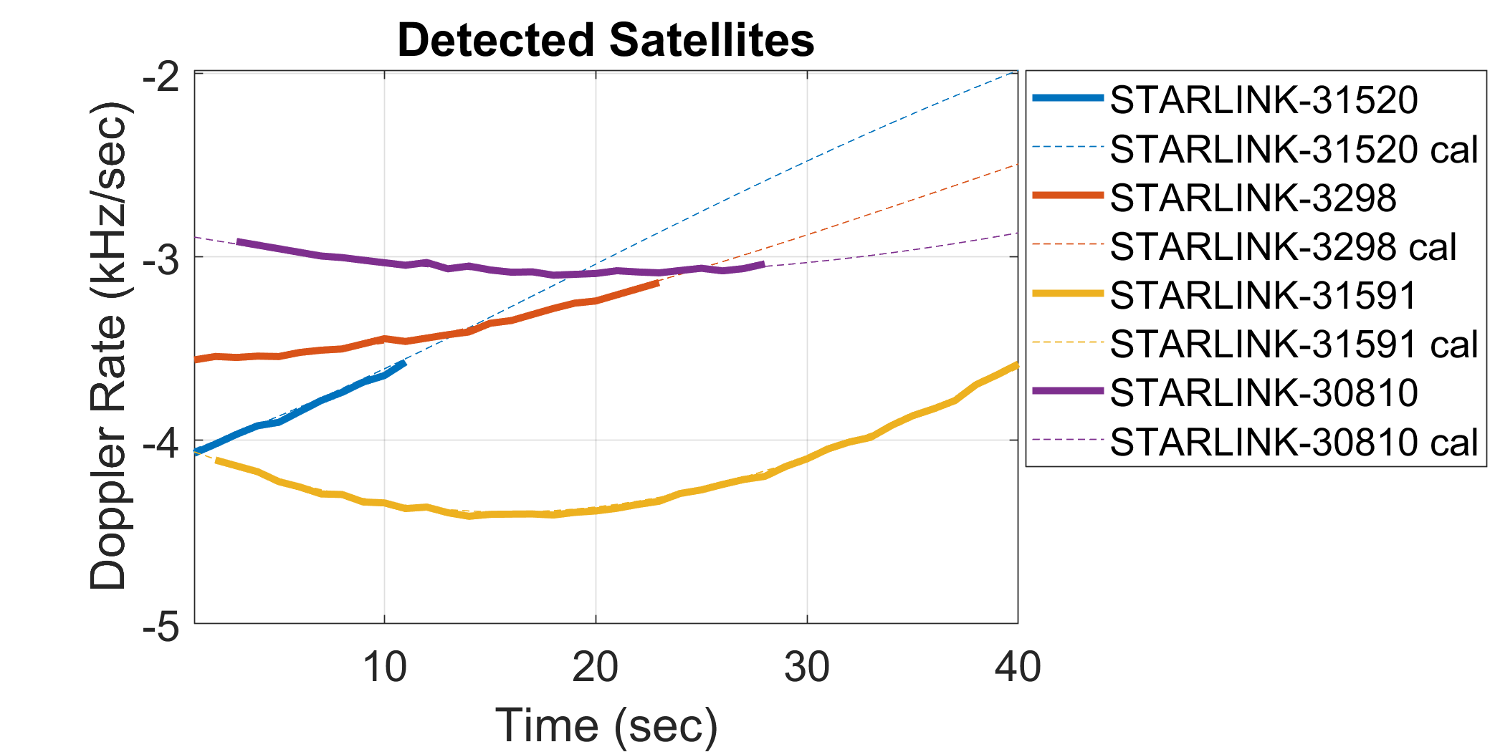
Typical Results
The measured Doppler rate matches the one calculated by TLE very well
The Doppler rate can vary

Slide 17
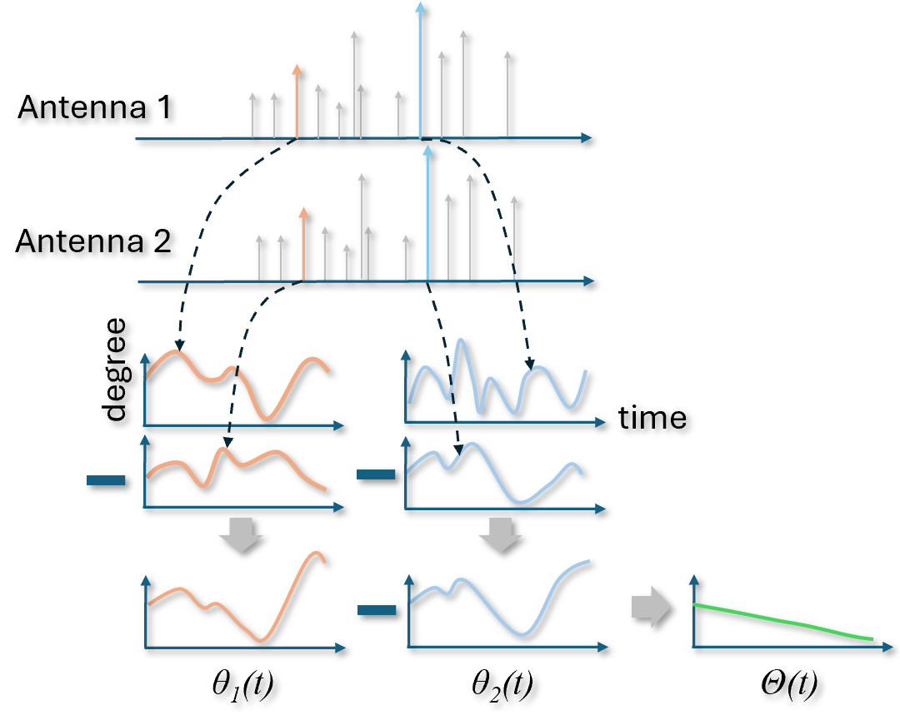
Phase Measurements
Pick the strongest beacon and use a Low Pass Filter of 100 Hz wide to obtain the time-domain signal

Slide 18
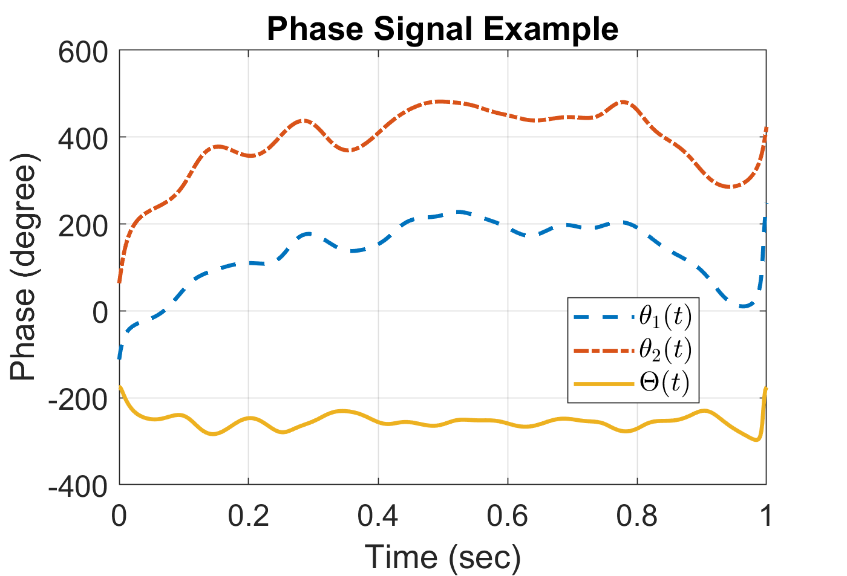
An example
Processed performed every one second
Need to dechirp first (cancel Doppler rate)

Slide 19
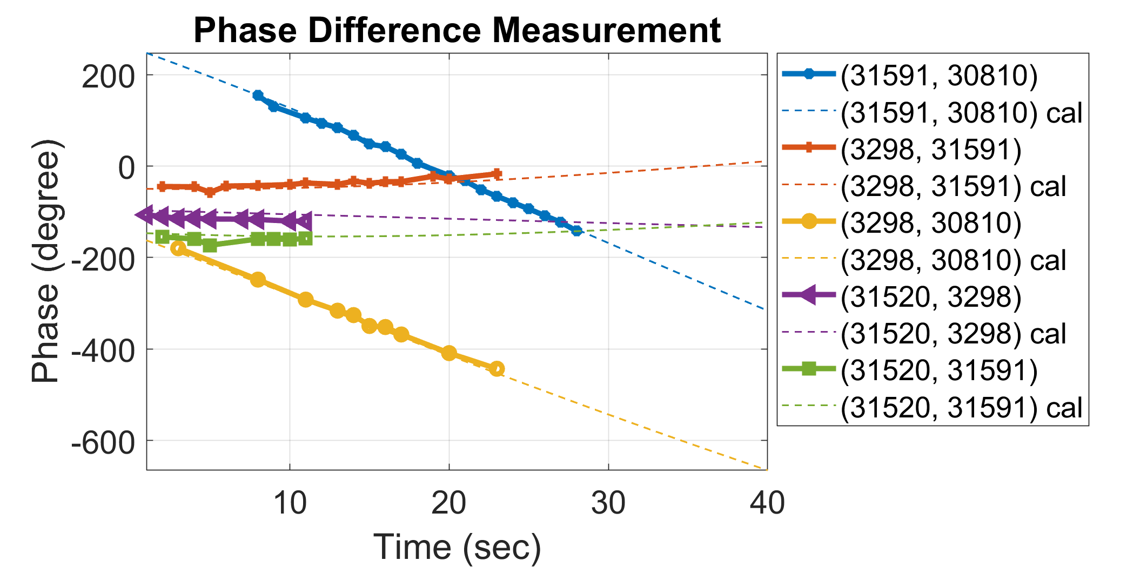
Typical Results
Phase measurement and calculation based on TLE usually match very well

Slide 20
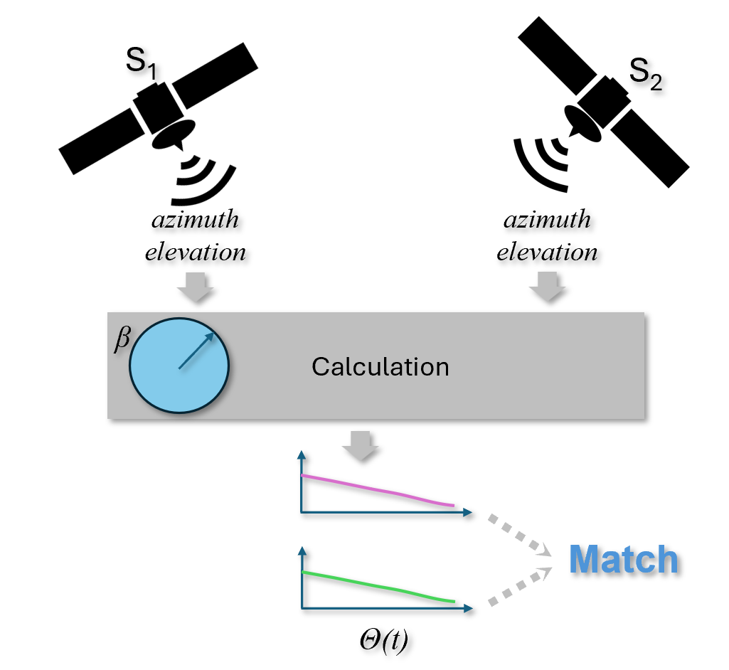
Orientation Estimation
Use (Az,El) as input and try possible values of angles and use the one best match the measurement

Slide 21
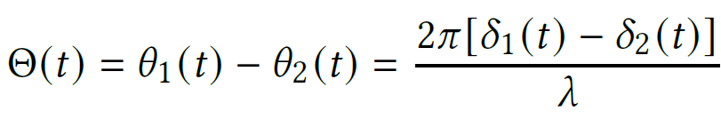
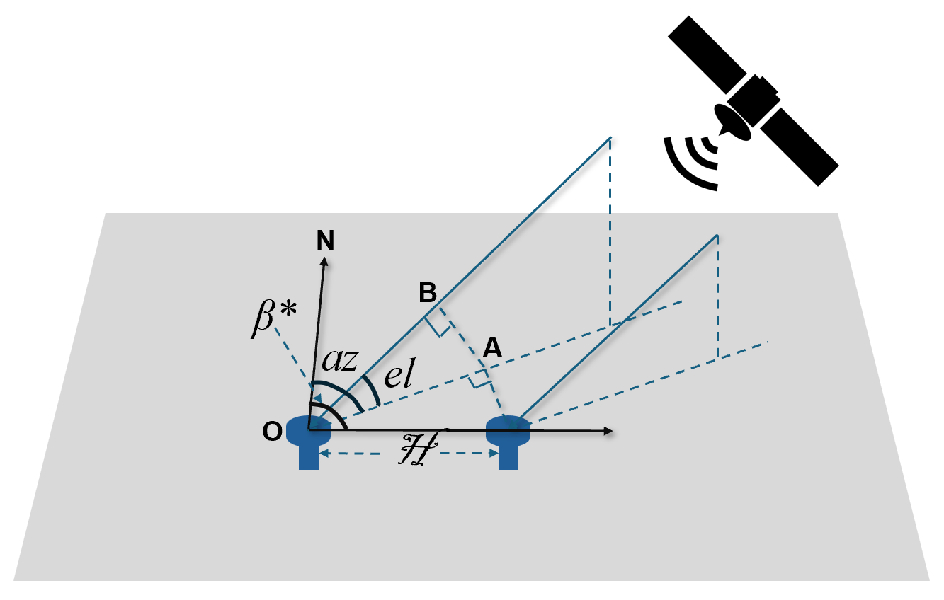
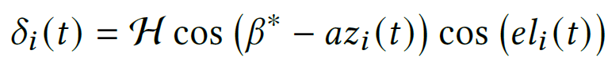
Phase Calculations

Slide 22
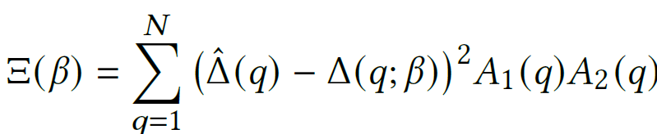
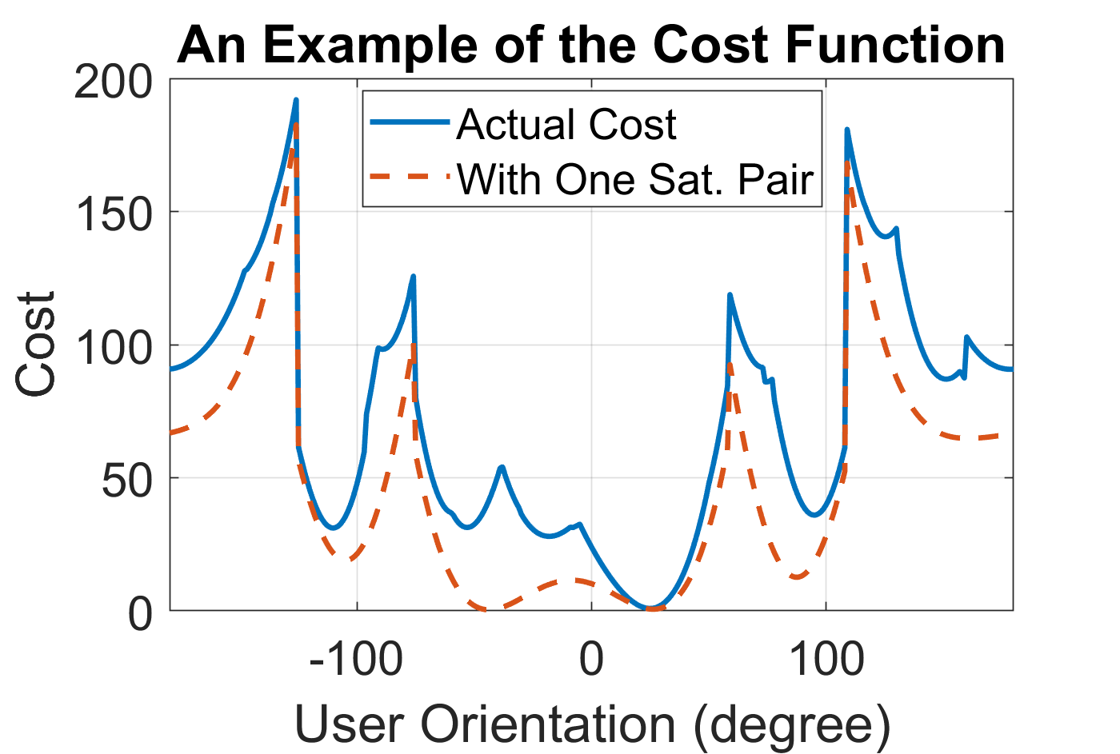
Cost Function

Slide 23
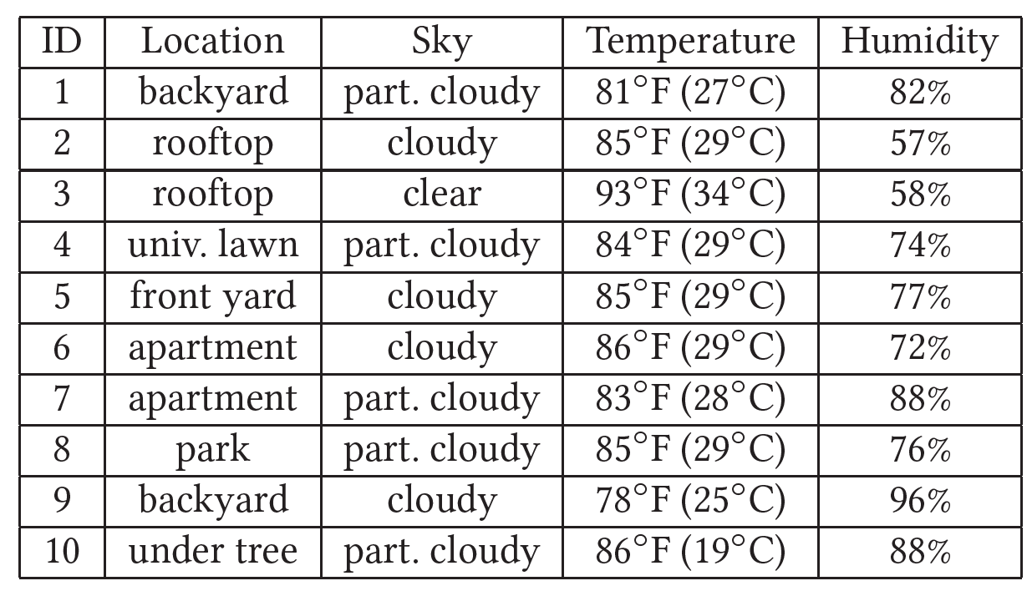
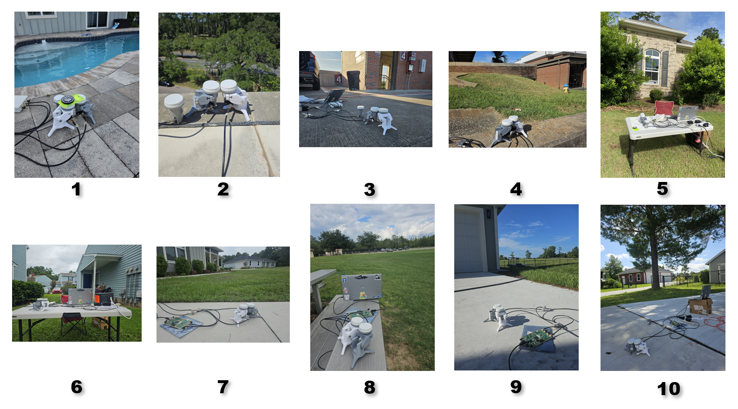
Evaluation

Slide 24
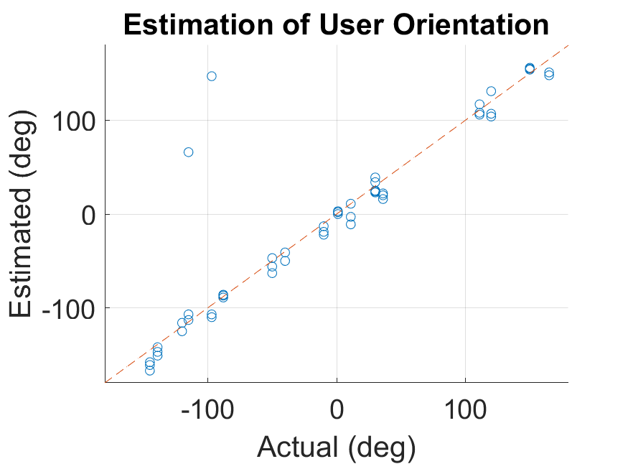
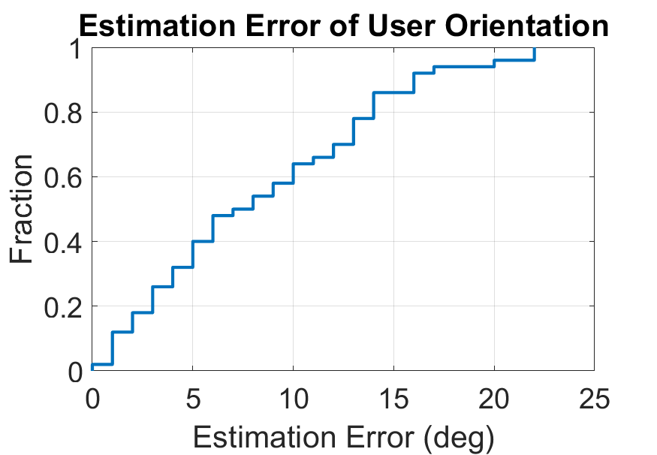
Estimation Accuracy

Slide 25
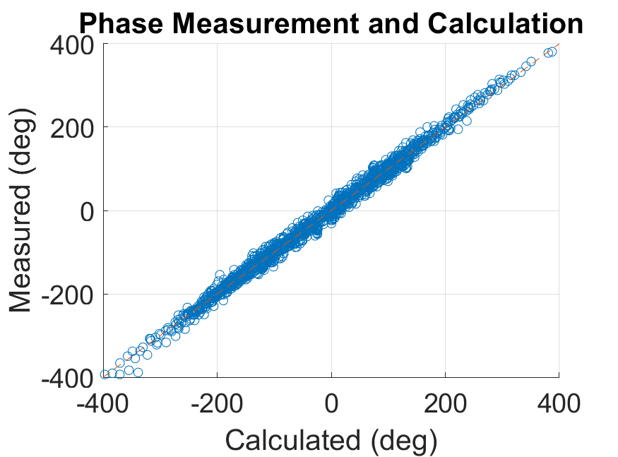
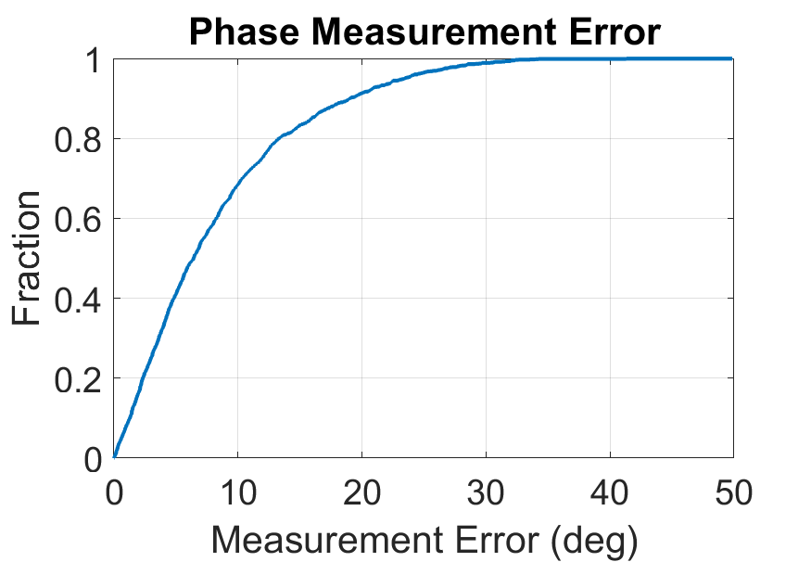
Phase Measurement

Slide 26
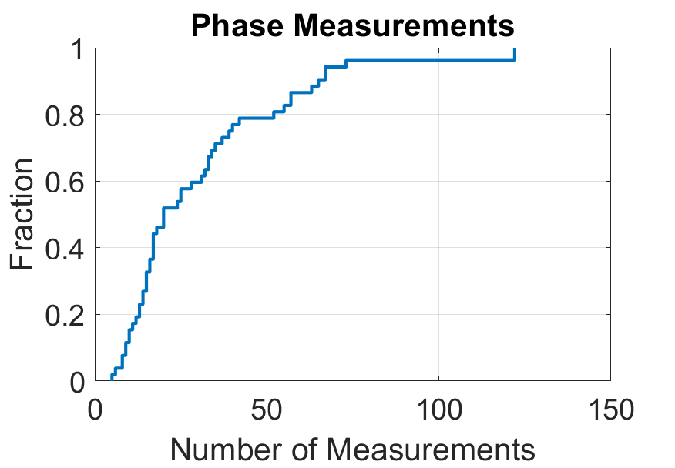
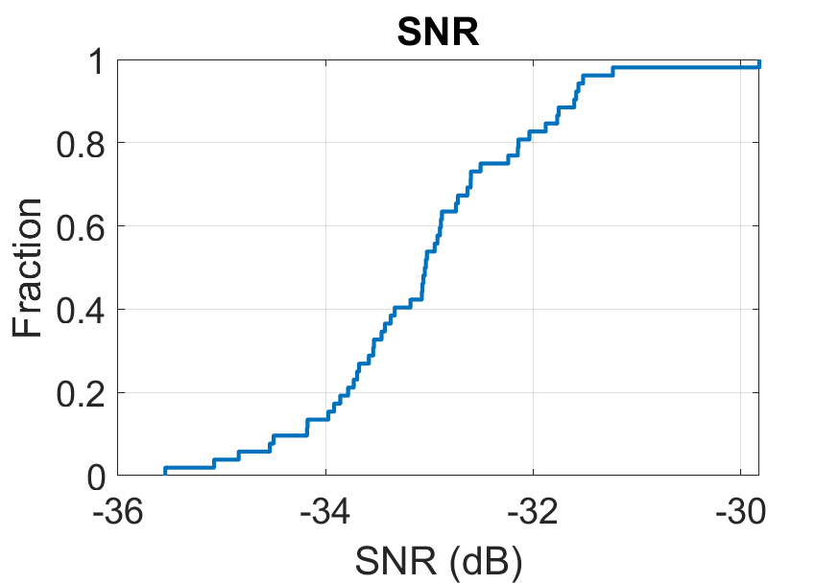
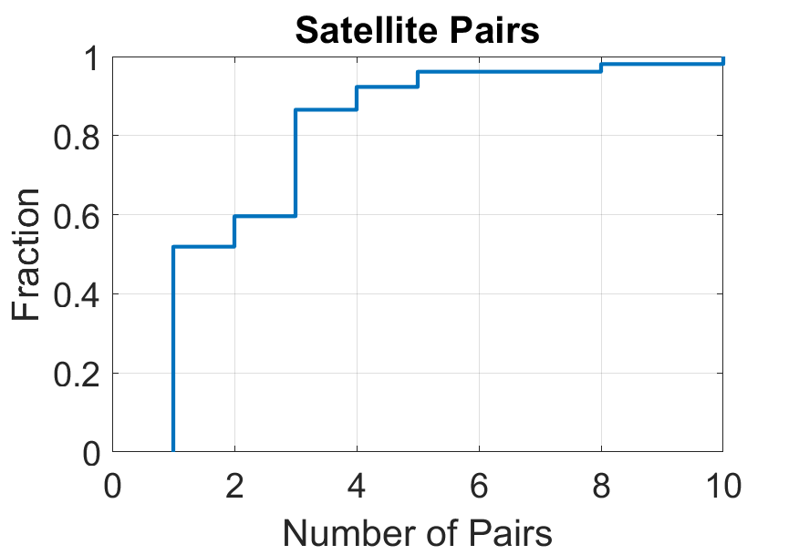
Experiment Information

Slide 27
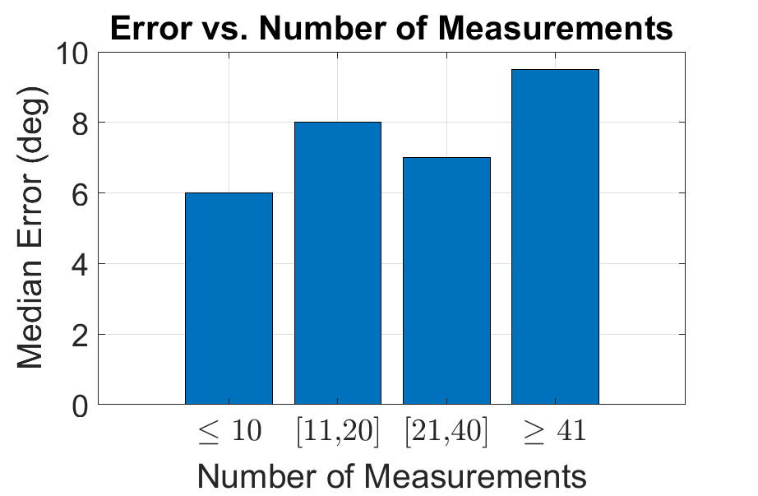
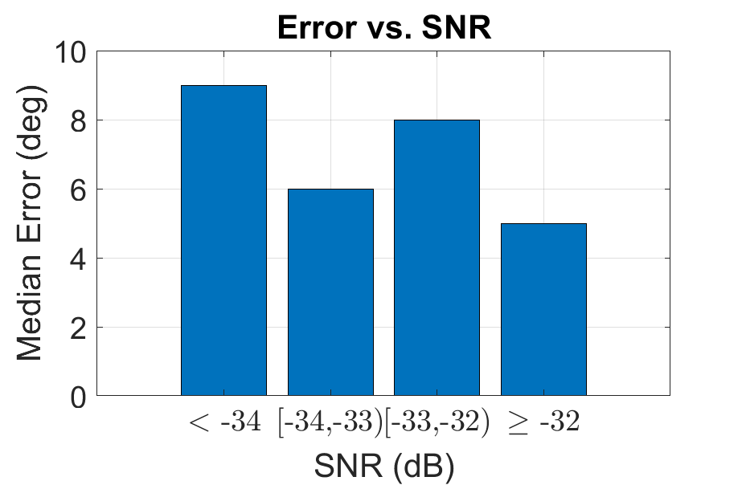
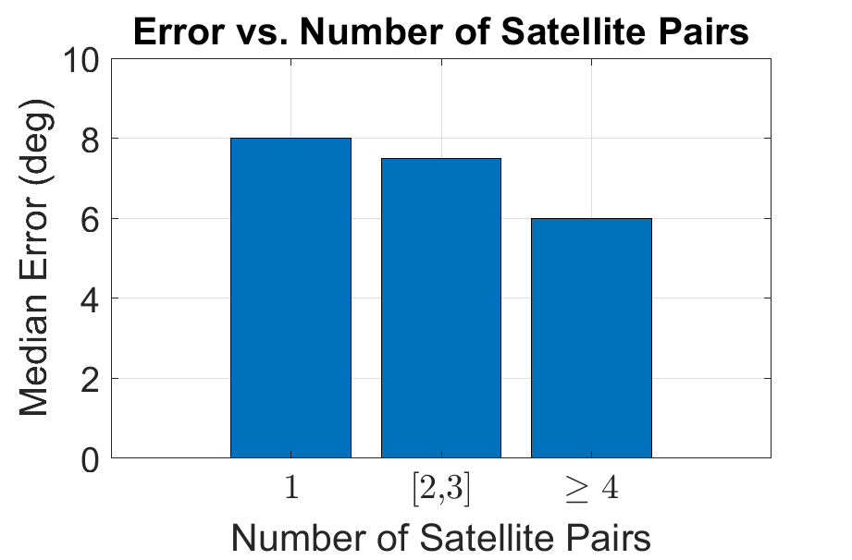
Experiment Analysis

Slide 28
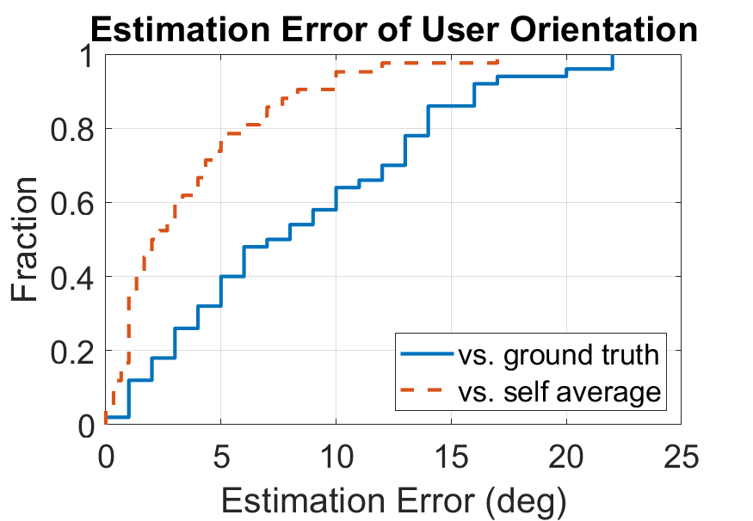
Self Average

Slide 29

This Photo by Unknown Author is licensed under CC BY-NC

